Slide 1
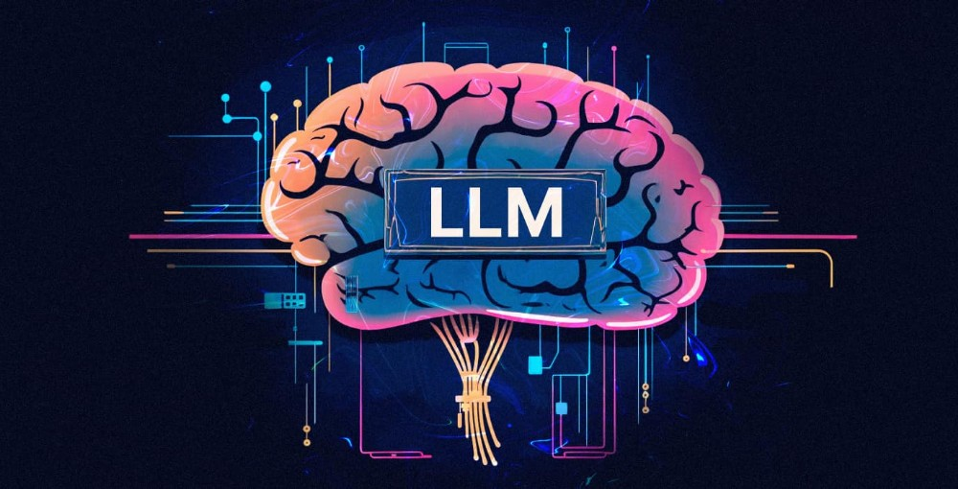
Token Trim
TEAM-ID : 13689
LANGUAGE MODEL

Slide 2




WHAT I HAVE MADE
TOKEN TRIM
We analyze 2 approaches for prompt compression.
Selective Context
LLM Lingua
We will also develop a RAG based AI agent which has access to various tools like APIs, local vectore_store for question answering local/personal docs
In support of our work, we also plan to prepare some front-end which can help the user see the effects of above prompt compression techniques in visuals.
TOKEN TRIM

Slide 3


Approach-1 Selective Context
Step-1 : Computing self-information of each token in prompt given previous tokens
Step-2 : Merging into lexical units
Step-3 : Selecting lexical units based on some threshold on self-information.
It needs a Causal LM, to generate self-information of tokens.

Slide 4
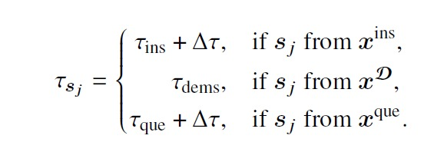
Approach-2 LLMLingua
Step 1: Budget Controller
Decide how much compression ratio to allocate to instructions, questions and demonstration
Step-2: Iterative Token-Level Compression
It then breaks the prompt in segments and picks the segments based on a threshold.

Slide 5

FURTHER PLANS
FRONTEND
FINE-TUNING MISTRAL-7B
Creation under development, it will enhance user interaction with techniques implemented.. Chatbot for docs Q&A
To align the self-information generation with domain, we plan to fine-tune Mistral-7B on medical data.

Slide 6



THANK YOU
Team
SARVAGYA PORWAL (Leader)
SHIVAM KUMAR Puspendra Mahariya

